Slide 1
Notes for the teachers
not for the students
Dear colleagues,
There are some special instructions below the pages. If you read it before presentation, it may be helpful to you to present the class effectively.
Notes:
Please follow the instructions here.

Slide 2
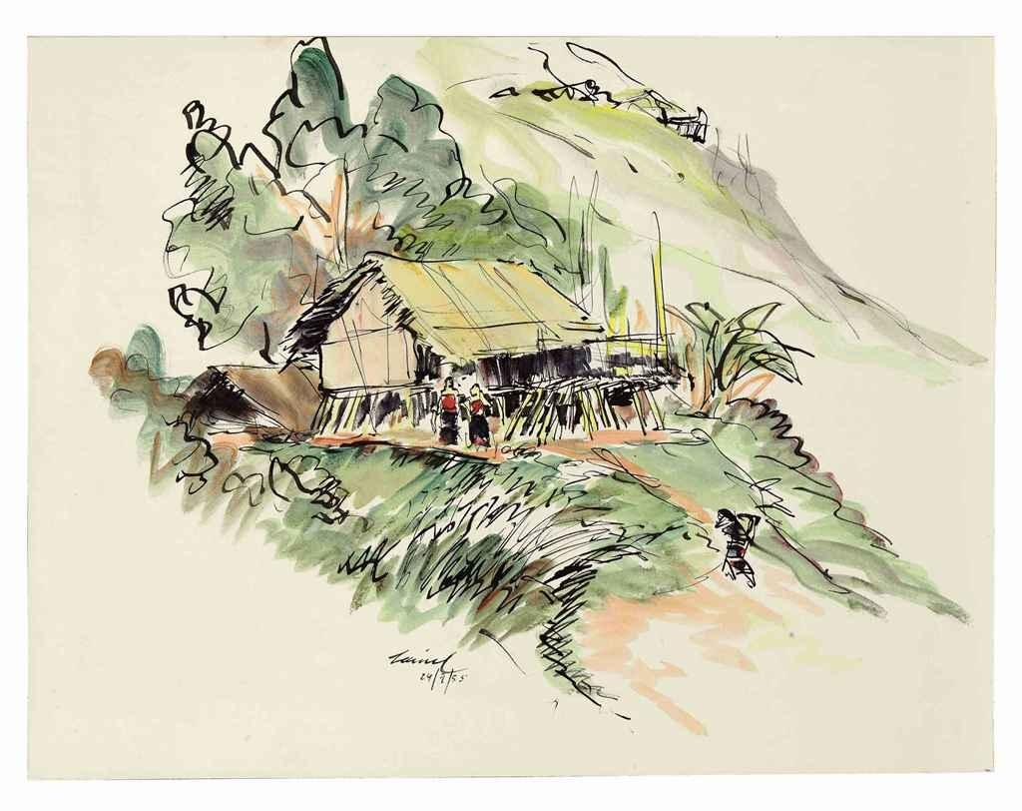
Welcome you all, dear students.
Notes:
Welcome slide. This picture is related to the topic. So I have chosen it. Teacher may change it if he wants.

Slide 3
Presenter & class identity
Md. Hasan Hafizur Rahman
Lecturer & Head of the
Department (English)
Building-5
Cambrian School & College
Baridhara, Dhaka
English For Today
Class IX-X
Notes:
Identity of presenter and class.

Slide 4
Watch & guess the video
What is the video about?
Notes:
First click in blank space, 2nd click on the package and third click on the blank.

Slide 5
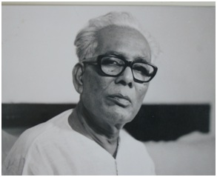
Art of-
Shilpacharya Zainul Abedin
Notes:
Students will tell this.

Slide 6
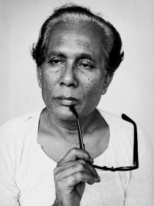
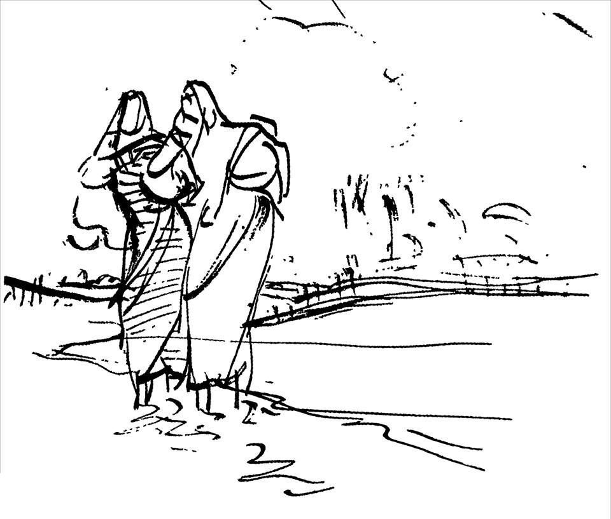
Our Today’s lesson is-
Zainul Abedin,
the greatest artist
Unit-7, Lesson-1
Notes:
Lesson declaration.

Slide 7
Learning outcomes
After we have studied this lesson, we will be
able to-
read and understand through silent reading
ask and answer question
write an article
Notes:
All the four skills will be focused in this lesson.

Slide 8
Let us know something about ________
Birth place : Kishoreganj
Date of birth : 29 December 1914.
In 1938 he graduated with the first position in first class.
He attended the Slade School of Arts, London during 1951-52.
He was titled ‘Shilpacharya’ (great teacher of art).
Zainul Abedin
Notes:
Information abut Zainul Abedin is transferred to the learners.

Slide 9
Brahmaputra Nod
Zainul Abedin was inspired to be an artist by the river Brahmaputra.
Notes:
A series of beauty of this river influenced Zainul Abedin to become an artist in future.

Slide 10
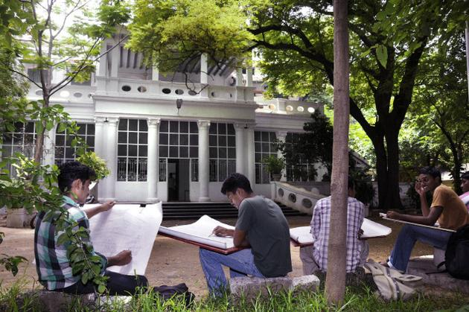
Government School of Art, Kolkata
After completing high school, he got admitted in this school.
Notes:
This is the institution where Zainul Abedin was taught art education.

Slide 11
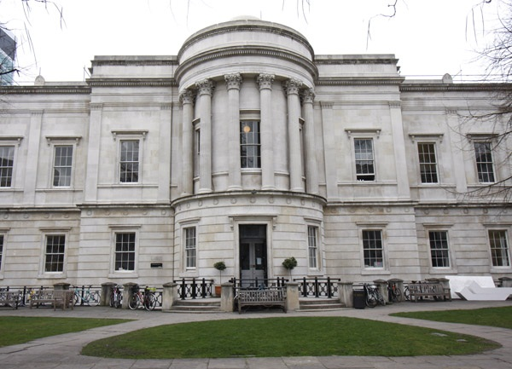
Slade School of arts, London
He attended the Slade School of arts in London from 1951-52.
Notes:
He passed here for two years in London.

Slide 12
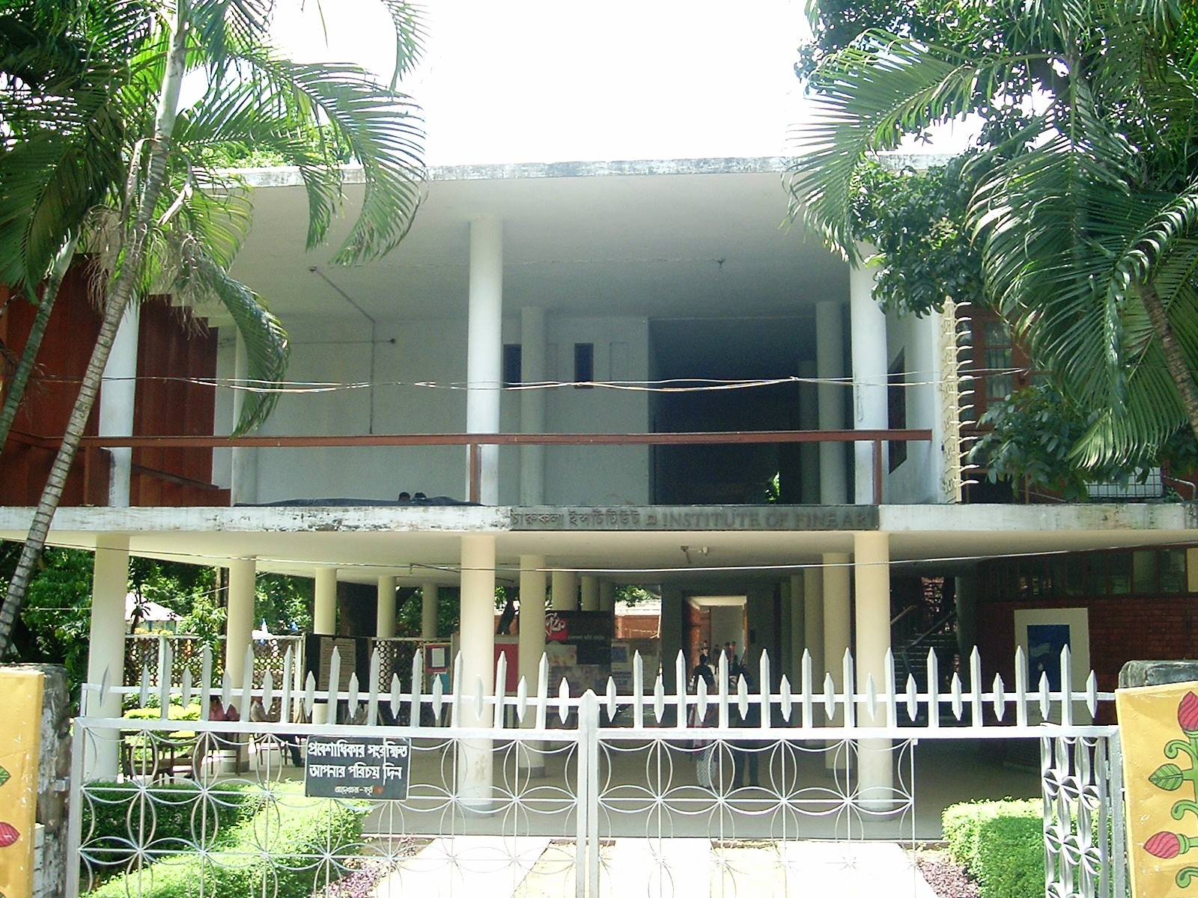
First art school, Dhaka. Now Art Institute, Dhaka
Zainul Abedin was the first principal of this institution.
Notes:
This was the first art school in Dhaka. But later its name was continued to Art Institute Dhaka.

Slide 13
was the founder of-
Notes:
Contribution of Zainul Abedin mentioned from here.

Slide 14
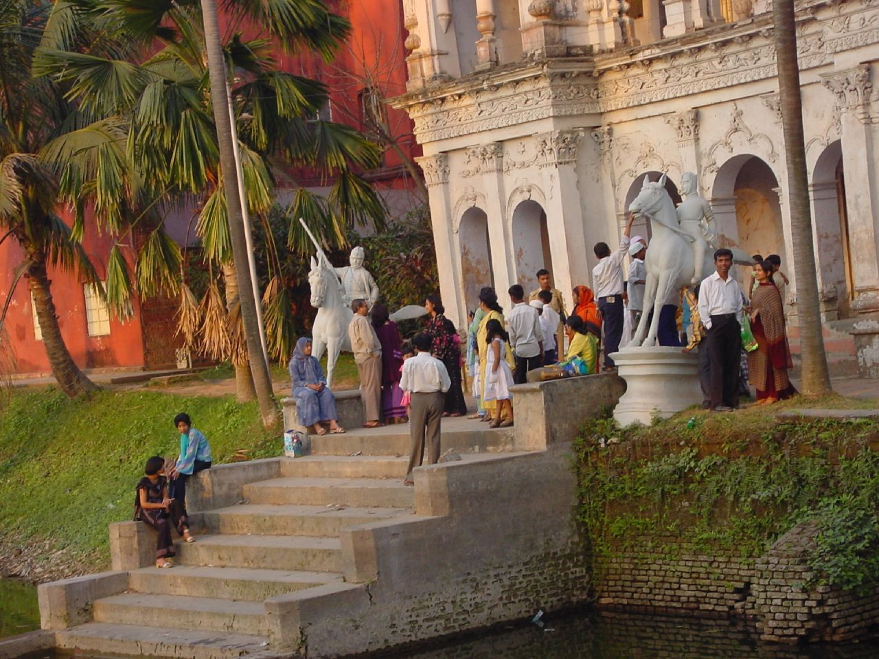
Folk Art Museum at Sonargaon,
Notes:
One of his contributions.

Slide 15
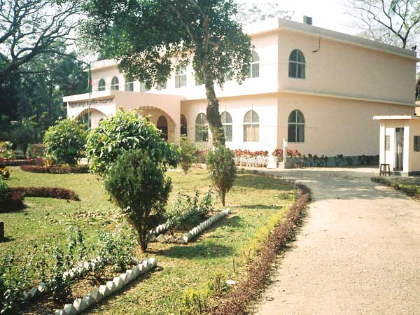
Zainul Abedin Shangrahasala, a gallery of his own works in Mymensingh.
Notes:
Another contribution.

Slide 16
Zainul Abedin designed the page of Constitution
of Bangladesh.
Notes:
A great contribution.

Slide 17
Key words/new words option
Try to tell the meaning of the word then follow the picture and match the meaning. Make a sentence with the main word.
Notes:
There are some new and critical words in this lesson. So these meaning of the words will help them to understand the subject matter during silent reading.

Slide 18
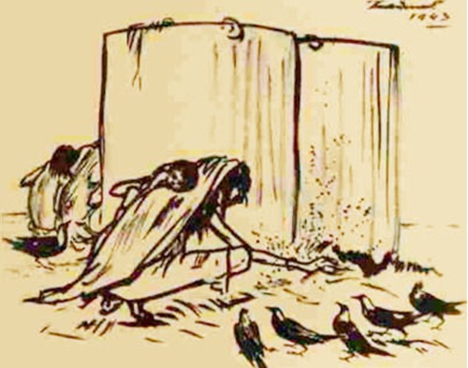
Famine Sketches
Meaning
Drawing of a famine picture
Zainul Abedin was famous for drawing famine sketches.
Notes:
Please go according to animation.

Slide 19
Sinister
Meaning
harmful, injurious, pernicious,
Timid people are afraid of sinister face.
Notes:
Please go according to animation.

Slide 20
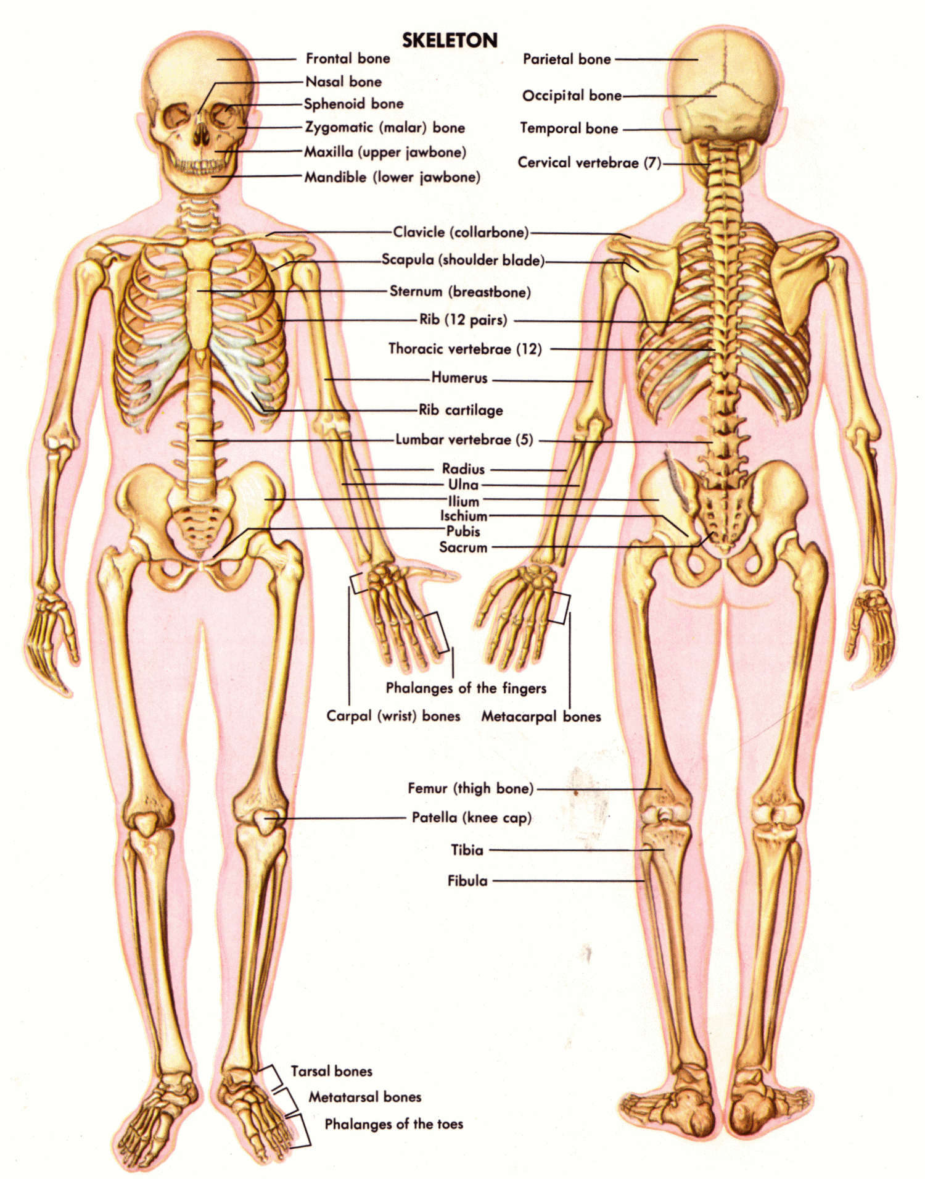
Skeletal
Meaning
Frame or structure of body
The picture shows the skeletal parts of human body.
Notes:
Please go according to animation.

Slide 21
Plight
Meaning
Commitment, promise, pledge, undertaking, promising
It is our plight to protect addiction.
Notes:
Please go according to animation.

Slide 22
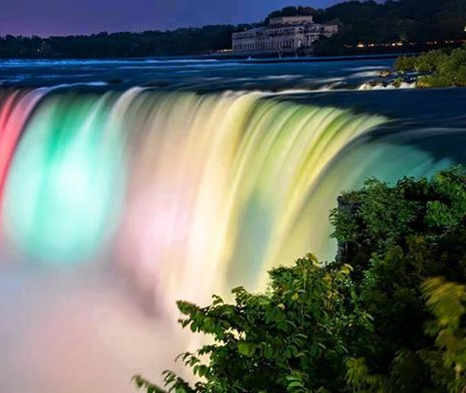
Depict
Meaning
Representing by drawing
A painter depicts his imagination by drawing pictures.
Notes:
Please go according to animation.

Slide 23
Compassion
Meaning
sympathy, empathy,
We should have compassion to the helpless.
Notes:
Please go according to animation.

Slide 24
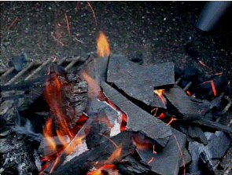
Charcoal
Meaning
coal, cinder, burning object
Carbon monoxide is produced by burning charcoal.
Notes:
Just click and advance according to animation.

Slide 25
Milestone
Meaning
A guide to way
destination
Cambrian College is a milestone of education.
Notes:
Just click and advance according to animation.

Slide 26
Lets have a tour from the text.
A Read the text and answer the questions that follow.
Dear learners, Open you text book at page 83 and start silent reading from, “ The pioneer of Bangladeshi modern art Zainul Abedin is widely acclaimed for his Bengal ‘Famine Sketches’……………………………………………………….. 29 December 1914 and died on 28 may 1976.
Questions
Write in details how Zainul Abedin portrayed the sufferings of people.
What influence did the river Bramhmaputra have on Zainul Abdin? How did he show this influence in his works?
What did these work earn him later in his life?
How did his art help to intensify the noncooperation movement?
Notes:
Silent reading option. Please help the learners to understand the topic. Teacher may monitor this option moving in the class room.

Slide 27
A Read the text and answer the questions that follow.
The pioneer of Bangladeshi modern art Zainul Abedin is widely acclaimed for his Bengal ‘Famine Sketches’. Through a series of sketches, Zainul not only documented the harsh famine of 1940 but also showed its sinister face through the skeletal figures of the people destined to die of starvation in a man-made plight. He depicted these extremely shocking pictures with human compassion. He made his own ink by burning charcoal and using cheap ordinary packing paper for sketching. He produced a series of brush and ink drawings, which later became iconic images of human sufferings. Zainul developed a knack for drawing and painting when he was a high school student. After completing high school, he got admission to the Government School of Art, Calcutta (now Kolkata). He graduated with the first position in first class in 1938. He was appointed teacher of the Art School while he was still a student there. He also attended the Slade School of Arts, London in 1951-52. Zainul Abedin is considered the founding father of Bangladeshi art. He was an artist of outstanding talent and earned international reputation.
Notes:
This is for the teachers. He may use it as any purpose. Suppose, some students have not brought the text books. It may be helpful to them for silent reading.

Slide 28
For his artistic and visionary qualities, he is referred to as Shilpacharya meaning ‘great teacher of art’ in Bangladesh. He was the first Principal of the first art school in Dhaka in East Pakistan (now Bangladesh). He organized the Nabanna (harvest) exhibition in 1969. In the exhibition, a 65-foot long scroll portraying the rural East Pakistan in phases from abundance to poverty. This intensified the already heightened non-cooperation movement against the Pakistan regime. The exhibition was symbolic of the artists’ protest and a milestone in demanding cultural and political freedom. Zainul’sdynamic style of work is evident in a 30 foot long scroll painting called Manpura, which was done to commemorate the death of hundreds and thousands of people in the devastating cyclone of 1970. He designed the pages of Constitution of Bangladesh. He founded the Folk Art Museum at Sonargoan, and also Zainul Abedin Shangrahasala, a gallery of his own works in Mymensing in 1975. The river Brahmaputra plays a predominant role in his paintings and a source of inspiration all through his career. Much of his childhood was spent near the scenic beauty of the river Brahmaputra. A series of water colours that Zainul did as his tribute to the river earned him the Governor’s Gold Medal in an all-India exhibition in 1938. This was the first time when he came into spotlight and this award gave him the confidence to create his own visual style.
Zainul was born in Kishoreganj on 29 December 1914 and died on 28 May 1976.

Slide 29
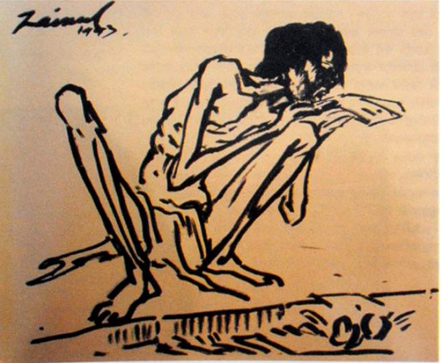
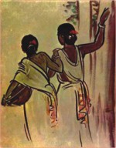
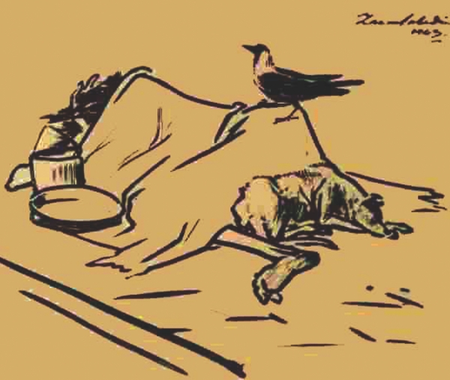
B Look at the series of pictures. Work in groups and talk about them. Now briefly write about what each picture portrays.
Picture 1
Picture 2
Picture 3
Notes:
Teacher may conduct this option giving the learners group works. Just the group will write two or three sentences about the pictures.

Slide 30
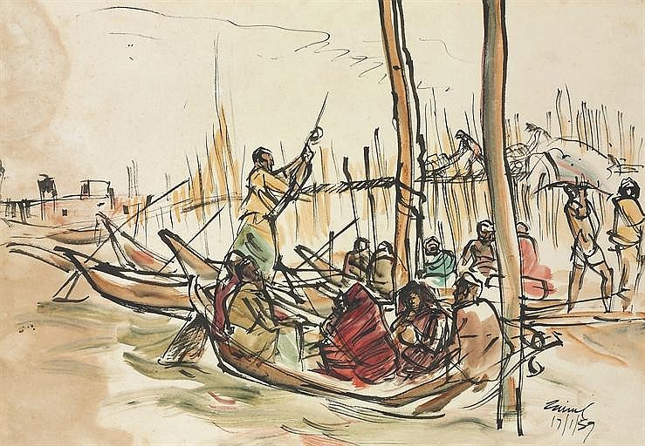
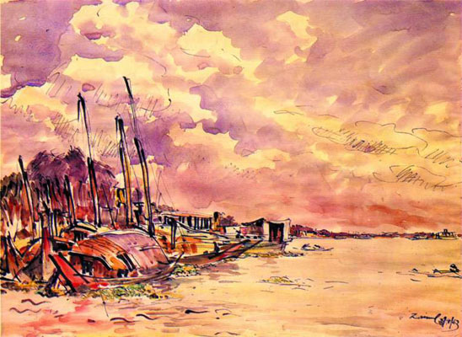
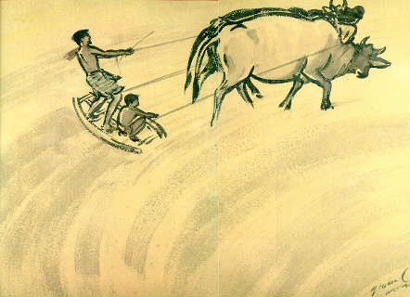
Picture 4
Picture 5
Picture 6
Picture 7
Notes:
Same as above.

Slide 31
C Listen to the CD/ teacher and tick the word/s you hear.
1. The US Ambassador to Bangladesh considers Zainul Abedin a
a great painter. b popular painter.
c master painter. d unique painter.
2. Zainul’s art gallery was set up in ---------------.
a 1972. b 1973.
c 1974. d 1975.
3. The number of Zainul’s artwork preserved in the gallery is ---------
a 53. b 62.
c 65. d 75.
Notes:
This is a CD related function. Whenever we will get the CD, we will provide this section then. Teacher may conduct it himself also.

Slide 32
4 The US Ambassador commented that the museum is a global
a wealth. b asset.
c gift. d treasure.
5 Mozena visited the gallery for
a 3 hours. b 2 hours.
c 1 hour. d ½ hour.
D Listen to the text again and answer the questions.
1 Where is Zainul’s art gallery situated?
2 When did the Ambassador visit the gallery?
3 Who else were there with the Ambassador during his visit?
4 Which artworks of Zainul did the Ambassador specially mention?
5 How did Moneza feel after visiting the gallery?
Notes:
Same as above.

Slide 33
Home Assignment
Write a paragraph on the life and activities of Zainul Abedin.
Notes:
Teacher may tell the learners to write a paragraph or summery of Zainul Abedin from the total topic for the next class as home work.

Slide 34
Thank you all.
Notes:
Last greeting.

